Slide 1
Chapter 2: Working with Hibernate

Slide 2
Learning Objectives
Struts Flow of Execution
Introducing Struts Elements
Struts View (JSP)
Action Servelet
RequestProcessor
FormBean(ActionForm)
Built-in Action classes

Slide 3
Struts 2 Execution and Flow
The architecture and flow of struts 2 application, is combined with many components such as Controller, ActionProxy, ActionMapper, Configuration Manager, ActionInvocation, Inerceptor, Action, Result etc.
Here, we are going to understand the struts flow by 2 ways:
struts 2 basic flow
struts 2 standard architecture and flow provided by apache struts

Slide 4
Struts 2 basic flow
User sends a request for the action
Controller invokes the ActionInvocation
ActionInvocation invokes each interceptors and actionA result is generated
The result is sent back to the ActionInvocation
A HttpServletResponse is generated
Response is sent to the user

Slide 5
Struts 2 standard flow (Struts 2 architecture)
User sends a request for the action
Container maps the request in the web.xml file and gets the class name of controller.
Container invokes the controller (StrutsPrepareAndExecuteFilter or FilterDispatcher). Since struts2.1, it is StrutsPrepareAndExecuteFilter. Before 2.1 it was FilterDispatcher.
Controller gets the information for the action from the ActionMapper
Controller invokes the ActionProxy
ActionProxy gets the information of action and interceptor stack from the configuration manager which gets the information from the struts.xml file.
ActionProxy forwards the request to the ActionInvocation
ActionInvocation invokes each interceptors and action
A result is generatedThe result is sent back to the ActionInvocation
A HttpServletResponse is generated
Response is sent to the user

Slide 6
Introducing Struts Elements
A dynamic Struts 2 application has seven building blocks:
Pages with Struts Tags
Message Properties
Actions
Interceptors
Validators
Results
Annotations and Deployment Descriptors
The elements can be organized into three groups:
Pages and Message Properties are used to create the application user interface.
Actions, Interceptors, and Validators process an incoming request, in order to render a page, or some other Result.
Annotations and Deployment Descriptors are used to define the initial state for the other elements of a Struts 2 application.
Next we will take a look at these elements one by one.

Slide 7
Struts Views
We are using JSP view engine for defining our views layout.
We use simple tags defined in Struts 2 framework to create UI elements like labels, text boxes, buttons etc.
You can use JSTL or OGNL to populate values inside the tags.
Struts Views are composed of Tags, Tags can be classified into following categories:
Control Tags: to control the flow of page execution.
Data Tags: to manipulate the data displayed on a page.
Form Tags: for rendering of the user interface required for the Struts web applications.
AJAX Tags: uses the DOJO framework for the AJAX tag implementation.
These tags are used to create all Struts 2 UIs, you can create your own custom tag libraries or import tag libraries created created by third parties.
Let’s take a look at a practical example of an application created using these tags.

Slide 8
Struts Views: Tags & Messages
Often, much of the coding effort in a web application goes into the pages.
The Struts 2 Tags help us create localized, dynamic web applications with a minimum of coding, reducing effort by reducing code.
The key attribute on a tag refers to a Message Properties file, in the standard Java format, that contains the text to use as the label, along with other terms, such as error messages.
The two use cases for Message properties are normalization and localization.
Many terms are used more than once, and so should be defined only once.
Also, many enterprise applications are presented in multiple languages, and Struts 2 supports adding Message Property files for different locales.
The key attribute can also be used as the name of the property used to populate the field from a dynamic value passed to the page.
Underlying the tags is a powerful expression and binding language called OGNL, or Object Graph Notation Language. Most Java web developers will find the feature set similar to the JST Expression Language, but much more capable.
OGNL works hand-in-glove with the Value Stack, making it easy to retrieve a value from a certain scope, or just the last value pushed.

Slide 9
Struts: ActionServelet
ActionServlet represents the "controller" in the Model-View-Controller (MVC) design pattern for web applications that is commonly known as "Model 2".
The standard version of ActionServlet implements the following logic for each incoming HTTP request. You can override some or all of this functionality by subclassing this servlet and implementing your own version of the processing.
Identify, from the incoming request URI, the substring that will be used to select an action procedure.
Use this substring to map to the Java class name of the corresponding action class (an implementation of the Action interface).
If this is the first request for a particular action class, instantiate an instance of that class and cache it for future use.
Optionally populate the properties of an ActionForm bean associated with this mapping.
Call the execute method of this action class, passing on a reference to the mapping that was used (thereby providing access to the underlying ActionServlet and ServletContext, as well as any specialized properties of the mapping itself), and the request and response that were passed to the controller by the servlet container.

Slide 10
Struts: RequestProcessor
RequestProcessor contains the processing logic that the Struts controller servlet performs as it receives each servlet request from the container.
You can customize the request processing behavior by subclassing this class and overriding the method(s) whose behavior you are interested in changing.
Therefore a new new request processor can be plugged in without touching the Servlet. (Users did not like to subclass ActionServlet.)
RequestProcessor also made possible to use a different request processor for each module, if needed.
The problem is that RequestProcessor class was still an all-or-nothing object. Extensions like Tiles and Workflow both needed to subclass the RequestProcessor in different ways for their own reasons.
Experience has shown that requiring people to extend a single RequestProcessor class to customize the processing flow is cumbersome, and is particularly challenging when one wants to integrate custom processing from more than one source, because of Java's single inheritance limitations.
This lead to development of ComposableRequestProcessor, which is shipped with Struts 1.3.x.

Slide 11
Struts: RequestProcessor

Slide 12
Struts: ComposableRequestProcessor
For Struts 1.3, the RequestProcessor methods has been turned into Commands. Rather than subclassing a monolithic object, it is possible not just to replace Commands.
It is also possible to insert or remove Commands, if needed, to extend or streamline the request processing gauntlet.
The RequestProcessor class has been turned into ComposableRequestProcessor that invokes Command in the proper order. This order is defined with standard chain-config.xml file buried deep in Struts library, but can be easily overriden with custom config file if needed. To do this one need to define "chainConfig" property for ActionServlet in web.xml file. This propertly should contain comma-separated list of either context-relative or classloader path(s) to load commons-chain catalog definitions from.
If none specified, the default Struts catalog that is provided with Struts will be used.

Slide 13
Struts: ComposableRequestProcessor

Slide 14
Struts: Form Bean
A form bean is a type of Java bean. A form bean is an instance of a subclass of an ActionForm class and other FormBean class, which stores HTML form data from a submitted client request or that can store input data from a Struts action link that a user clicked.
You can divide Form Beans into two types.
Static Forms
Dynamic Forms
Static Forms :There are three types of Static Forms:
ActionForm
ValidatorForm
ValidatorActionForm
Dynamic Forms :There are three types of Dynamic Forms:
DynaActionForm
DynaValidatorForm
DynaValidatorActionForm

Slide 15
Struts: Static Forms
When you are using the Static Form, you need to do the following things.
You need to write a Java class by extending one of the above mentioned Static Forms.
You need to declare the fields same as JSP forms.
You need to write the set/get methods for all the fields.
If you want to validate form data you need to override the validate() method in the Form Bean class.
If you want to reset your form fields ,you need to override the reset() method in the Form Bean class.

Slide 16
Struts: Dynamic Forms
When you are using the Dynamic Form, you need to do the following things:
Write the field declaration inside the struts configuration file(No need to write Java class with private field and set/get method).
Dynamic Forms will reset automatically to default values(No need to override reset method).
Dynamic forms will use validation framework for the form validations (No need to override the validate method)

Slide 17
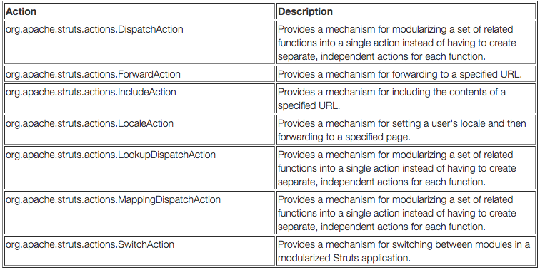
Struts: Built-In Actions

Slide 18
What are we learning in Next Chapter ?
You will learn about Struts Tag Libraries, DynaForm, LazyDynaBeans and Forwards
We will learn about:
Introduction to Struts Tag Libraries
Html Tag library
Bean Tag library
Logic Tag library
Nested Tag library
DynaActionForm & LazyDynaBean
Local Forwards & Global Forwards

Slide 19
Thank You !

